Slide 2
Reality is broken.

Slide 3
Reality is broken.
Change the rules.

Slide 4
Notes:
As programmers we make up rules. Routes and model hooks, these rules become concrete to us.

Slide 5
abstraction
Notes:
In computer science terms, we talk about abstractions.

Slide 6
abstraction
is a mechanism which permits the expression of
relevant details
and the suppression of irrelevant details.
Liskov, Programming With Abstract Data Types, 1974
Notes:
Programming With Abstract Data Types
What we desire from an abstraction is a mechanism which permits the expression of relevant details and the suppression of irrelevant details. In the case of programming, the use which may be made of an abstraction is relevant; the way in which the abstraction is implemented is irrelevant.
— Programming With Abstract Data Types
“The idea that software programming was an intellectual activity that required a great deal of thought was kind of controversial” — Liskov
https://medium.com/a-computer-of-ones-own/barbara-liskov-inventor-of-abstract-data-types-9f8908fdcf86

Slide 7
if S is a subtype of T, then objects of type T
may be replaced with objects of type S (i.e., objects of type S may substitute objects of type T)
without altering any of the desirable properties of that program
(correctness, task performed, etc.)
Liskov Substitution Principle
Notes:
This was an era when people used GOTO to structure their programs. Personally, I struggle to conceptualize how GOTO and structure can be used coherently in the same sentence.

Slide 8
“I wanted to make it easy for people to write good programs”
— Liskov
Notes:
“I had a very strong idea about what were good programs and what were bad programs,” she says. “I wanted to make it easy for people to write good programs, and while you can’t prevent people from writing bad programs, I didn’t want to make it too easy for them.”
https://www.technologyreview.com/s/416783/driven-to-abstraction/
“The idea that software programming was an intellectual activity that required a great deal of thought was kind of controversial” — Liskov https://medium.com/a-computer-of-ones-own/barbara-liskov-inventor-of-abstract-data-types-9f8908fdcf86

Slide 9
Notes:
Think about all the abstractions you use when you write code. All the classes you sub-class, the patterns that are encoded in the language. These are the rules we live by as programmers and we have the freedom to make up new patterns as needed, make up new rules to live by that are helpful.
Sometimes the abstractions get in our way, sometimes there are bugs in the system

Slide 10
“first you learn the value of abstraction, then you learn the cost of abstraction, then you're ready to engineer”
— @kentbeck
Notes:
https://twitter.com/kentbeck/status/258316233068396544?lang=en

Slide 11
Recognize when is the abstraction is wrong
Work at the right layer of abstraction
Notes:
Today, I’m going to talk about using the technical skills we know from programming to solve real world problems.

Slide 12
Reality is broken.

Slide 13
Perception != Reality

Slide 14



Slide 15


Slide 16
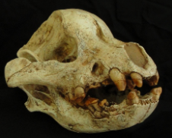

Slide 17
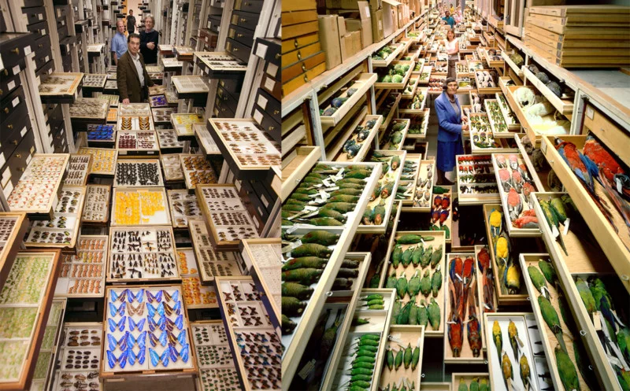

Slide 18
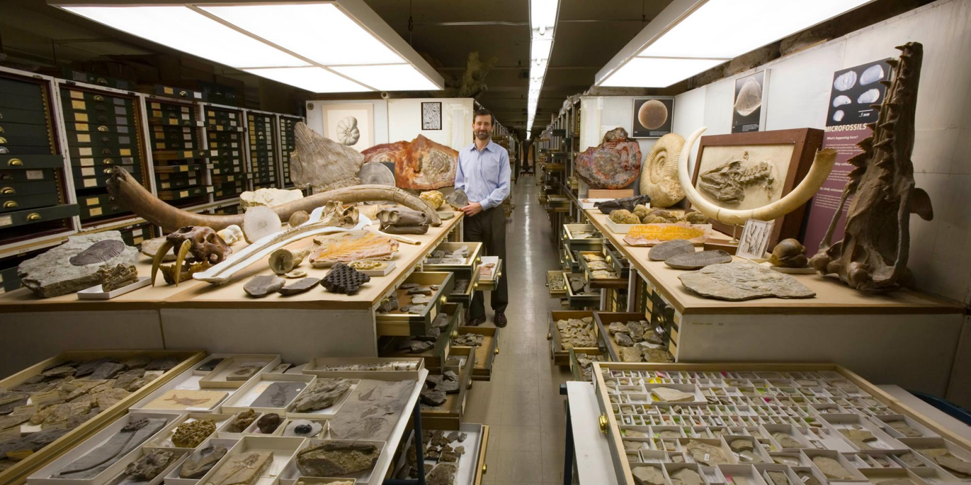

Slide 19
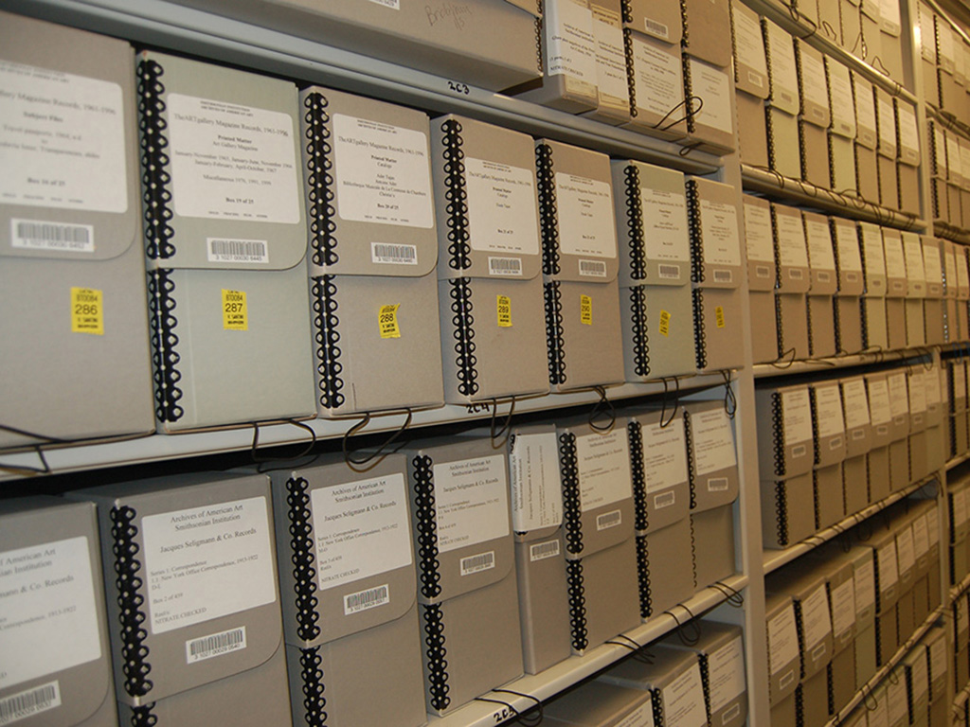
Notes:
Archives of American Art

Slide 20
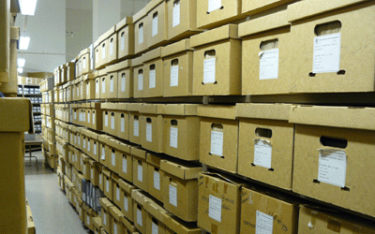

Slide 21
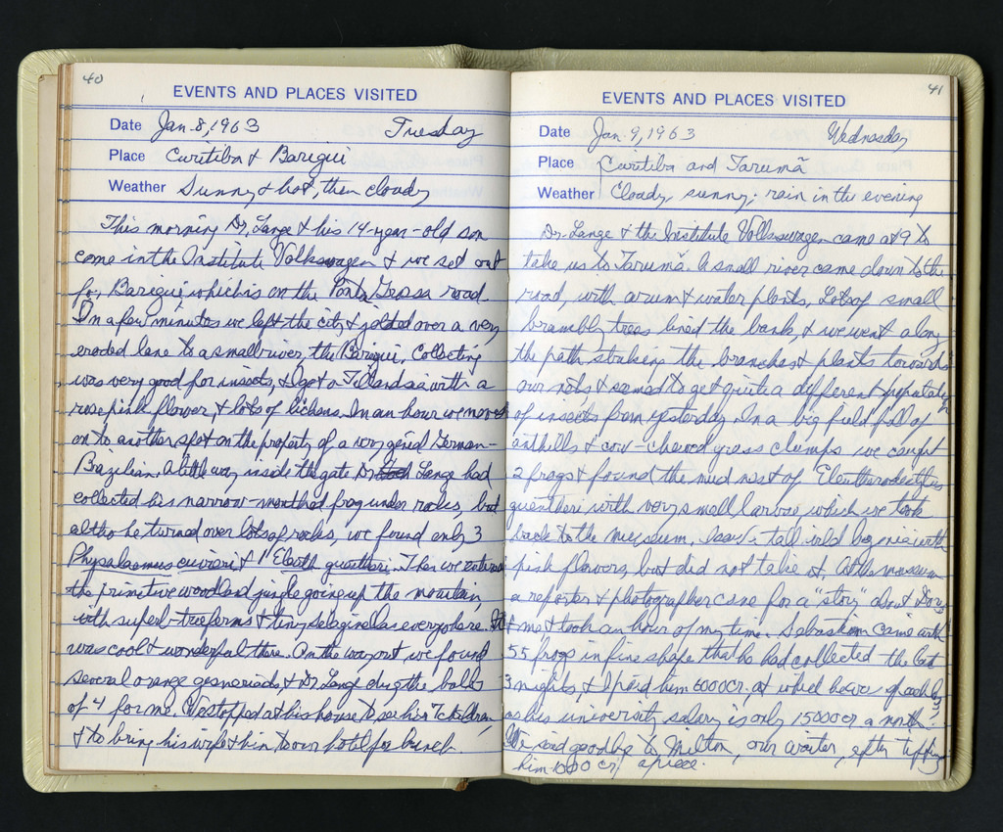

Slide 22
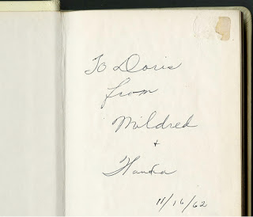

Slide 23
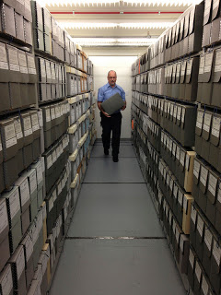
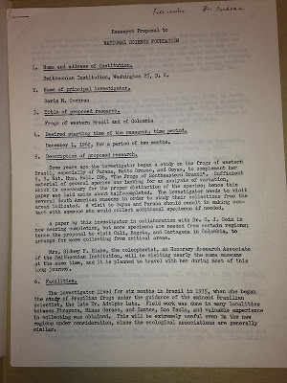
Mrs. Sidney F. Blake, the coleopterist, an Honorary Research Associate of the Smithsonian Institution, will be visiting nearly the same museums at the same time, and it is planned to travel with her during most of this long journey
Notes:
Blake was a botanist who studied at Harvard and then worked for 43 years at the USDA. Sidney could not be the travel companion referred to in the NSF grant -- he was not a coleopterist and a man.
coleopterist (plural coleopterists). One who studies beetles

Slide 24
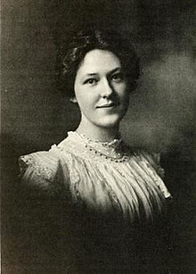
Mrs. Sidney F. Blake, the coleopterist, an Honorary Research Associate of the Smithsonian Institution, will be visiting nearly the same museums at the same time, and it is planned to travel with her during most of this long journey
Notes:
Doris Holmes Blake, née Doris Mildred Holmes, expert on chrysomelidae (leaf beetles
coleopterist (plural coleopterists). One who studies beetles

Slide 25
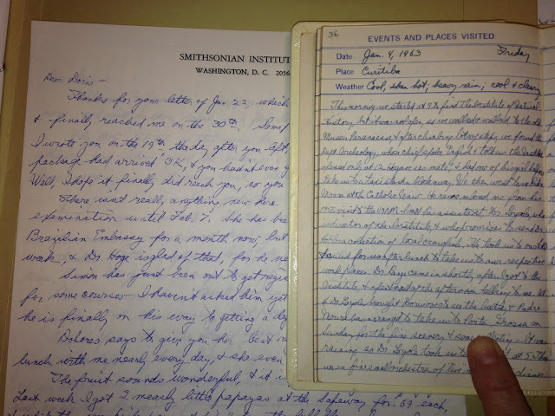

Slide 26
abstraction
is a mechanism which permits the expression of
relevant details
and the suppression of irrelevant details.
Liskov, Programming With Abstract Data Types, 1974
Notes:
Sometimes abstractions don’t serve us

Slide 27
What is relevant?
Notes:
Default = white/male
There is no default setting for humans
Sometimes abstractions don’t serve us.

Slide 28
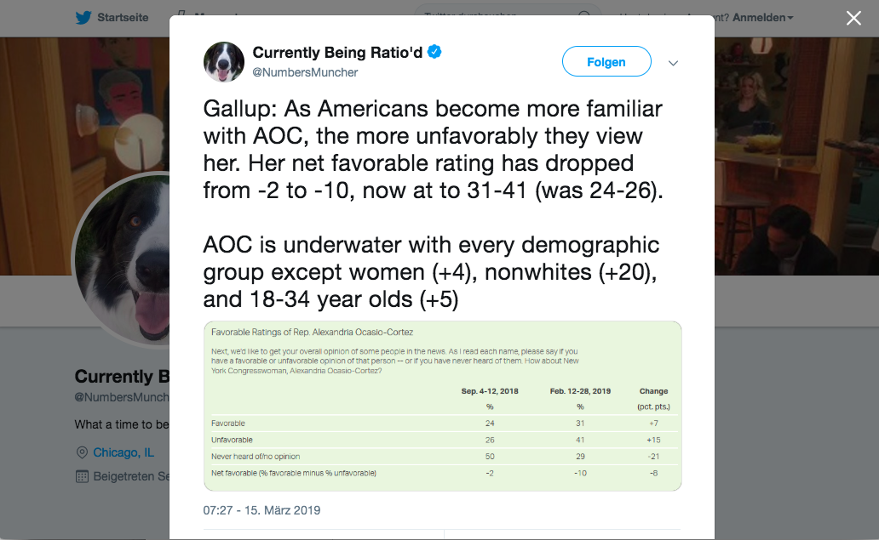
Notes:
https://web.archive.org/web/20190219165555/https://twitter.com/NumbersMuncher

Slide 29
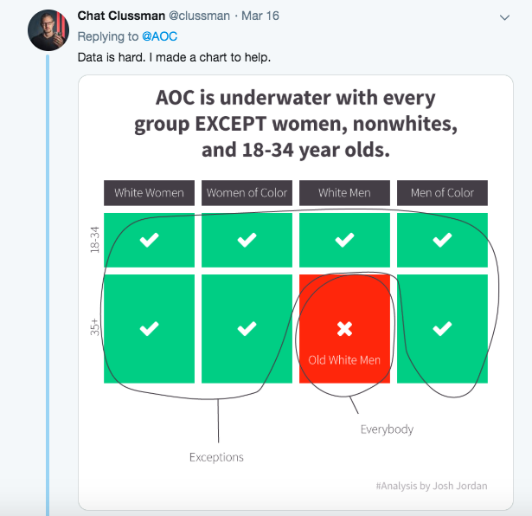
Notes:
https://twitter.com/AOC/status/1106953015804731393

Slide 30
wrong abstraction…
a condition-laden procedure which interleaves a number of vaguely associated ideas.
https://www.sandimetz.com/blog/2016/1/20/the-wrong-abstraction
Notes:
https://www.sandimetz.com/blog/2016/1/20/the-wrong-abstraction
If you find yourself passing parameters and adding conditional paths through shared code, the abstraction is incorrect.

Slide 31
just-world fallacy
the general belief that the world is morally ordered, such that people generally get what they deserve
Notes:
Researchers have found that when people observe suffering, they tend to tend to both derogate and blame victims for their suffering.
In the 1960s,Melvin Lerner hypothesized that the belief in a just world is crucially important for people to maintain for their own well-being. https://en.wikipedia.org/wiki/Just-world_hypothesis
Melvin Lerner was interested in understanding how regimes that cause cruelty and suffering maintain popular support, and how people come to accept social norms and laws that produce misery and suffering.
But people are confronted daily with evidence that the world is not just: people suffer without apparent cause.

Slide 32
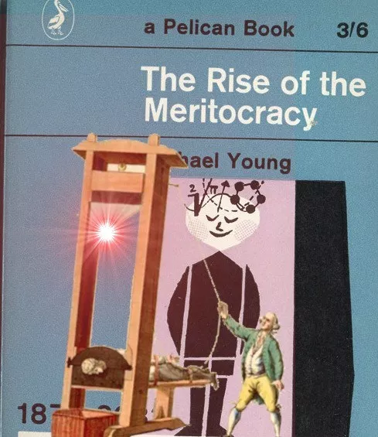
Notes:
The word “meritocracy” was originally coined in a satirical work of fiction….
"The Rise of the Meritocracy," in which aristocrats insist that they are the natural rulers of their society based on "objective" measures of worth ("merit" + "aristocracy" = "meritocracy") that are obviously tilted to favor them, a fact that they are conveniently blind to.
https://boingboing.net/2019/03/18/poes-law-for-oligarchs.html

Slide 33
Simply holding meritocracy as a value seems to promote discriminatory behavior.
Notes:
https://boingboing.net/2019/03/18/poes-law-for-oligarchs.html

Slide 34
Our relentless detection of patterns is part of our larger search for meaning...
Being Amused by Apophenia, Poulsen
Notes:
“Apophenia” or “patternicity” is when we see patterns that don’t exist
https://www.psychologytoday.com/us/blog/reality-play/201207/being-amused-apophenia

Slide 35
Our greatest challenge may be learning to bear incoherence.
Being Amused by Apophenia, Poulsen
Notes:
https://www.psychologytoday.com/us/blog/reality-play/201207/being-amused-apophenia

Slide 36
Notes:
The world is not fair, but I think in this context, the opposite of just is not unjust… though that is true. I prefer to think of this terribly frightening world we live in, as imperfect, unfinished. There are some pretty significant bugs that need fixing

Slide 37
Change the rules.

Slide 38
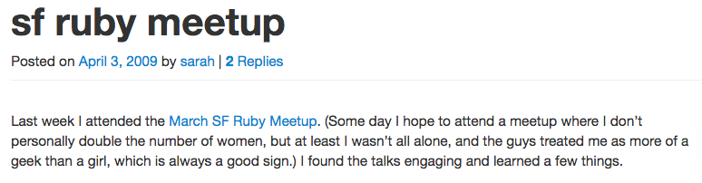
https://www.ultrasaurus.com/2009/04/sf-ruby-meetup/

Slide 39
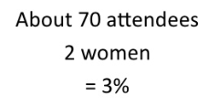
https://www.ultrasaurus.com/2009/04/sf-ruby-meetup/

Slide 40
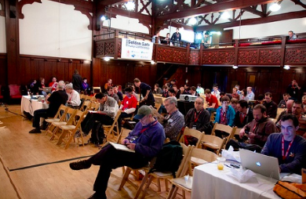

Notes:
By the time I heard about the Golden Gate Ruby conference it was sold out. I applied for and received a scholarship to attend

Slide 41
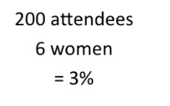
Notes:
By the time

Slide 42
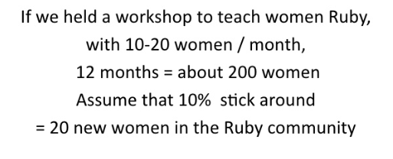
https://www.slideshare.net/sarah.allen/once-upon-a-time-1609821

Slide 43
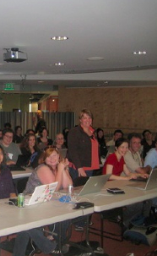
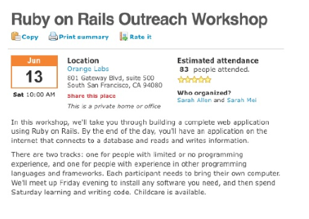

Slide 44
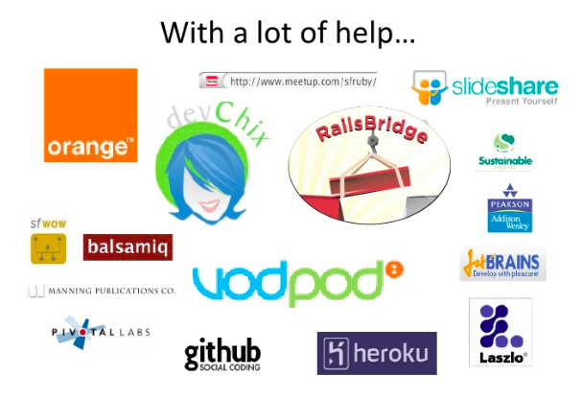

Slide 45
Iterate. Celebrate.
Iterate. Celebrate.

Slide 46
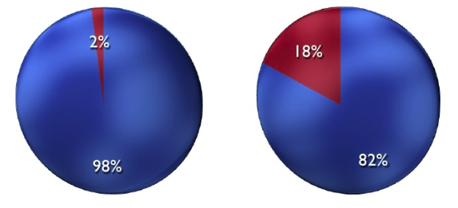
Moving the Needle: How the SF Ruby Community got to 18%
http://www.sarahmei.com/blog/2010/02/20/scale-8x-slides-posted/

Slide 47
“Focus on something you can fix”
— @sarahmei
Notes:
Do your homework. Set goals.

Slide 48
Find good people.

Slide 49
Find good people.
Make things together.

Slide 50
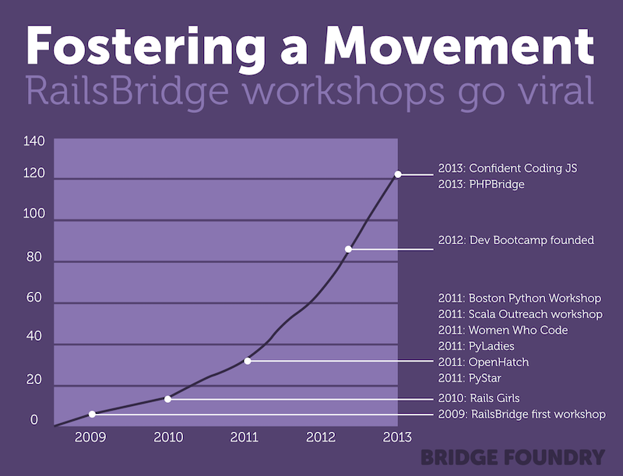
Notes:
Those early RailsBridge workshops and the stories we told fostered a movement, many groups and even companies told of how they were inspired to start something because they heard about what we were doing in the San Francisco Ruby meetup and pretty soon all over the world
https://bridgefoundry.org/2018/10/14/bridge-foundry-impact-and-vision

Slide 51
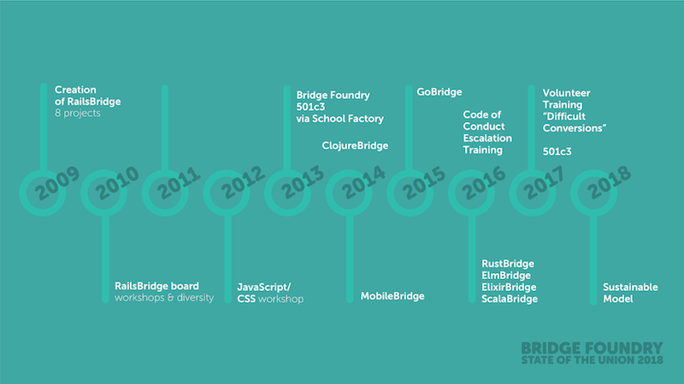
bridgefoundry.org

Slide 52
Tell the story.
Notes:
Lean Startup Conference story

Slide 53
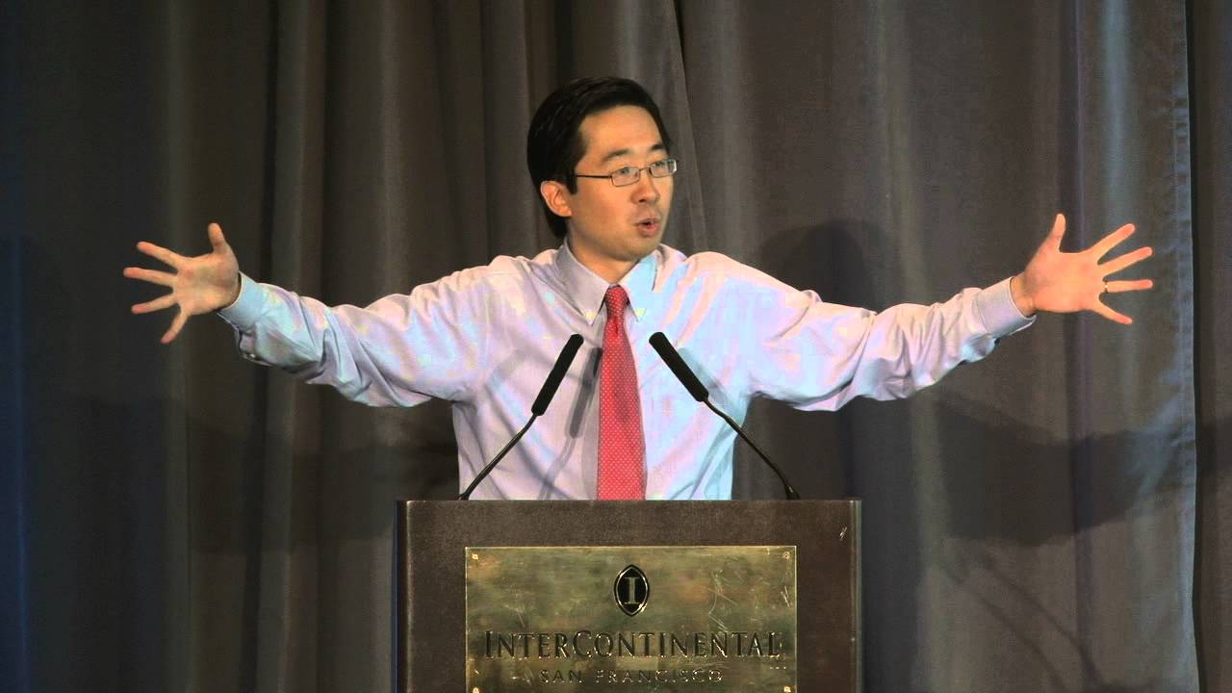
US CTO, Todd Park
Lean Startup Conference 2012

Slide 54


Slide 55
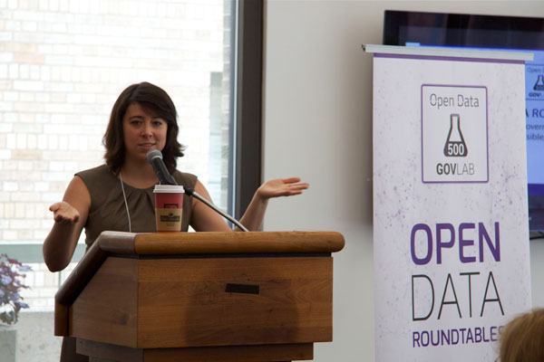
Eric Myers
White House, Office of the CTO
Notes:
CFPB

Slide 56
You can’t do that,
it’s illegal.

Slide 57
WAT?
Notes:
Lean Startup Conference

Slide 58

Notes:
Lean Startup Conference

Slide 59
Practice
Guidance
Policy
Regulation
Law
The Constitution
Notes:
FACA

Slide 60


Slide 61
WAT?
Notes:
Lean Startup Conference

Slide 63
That wouldn’t
happen here.
Notes:
stack

Slide 64
Code review
Automated tests
Metrics, CI/CD
Company policy
Privacy policy, ToS
Law
Notes:
DMCA, GDPR

Slide 65
Job posting
Hiring process
On-boarding process
Employee handbook
HR policy
Law
Notes:
Interview Rubrics

Slide 66
Write things down.
Notes:
Unwritten rules breed biased treatment.

Slide 67
Checklists.
Pre-mortems.
Retrospectives.
Notes:
Unwritten rules breed biased treatment.

Slide 68
Talk about why.
Notes:
Talk about why you do what you do. Encode your values in docunented or automated processes.
“Never ship on a Friday”

Slide 69
Reality is unfinished.
Invent good rules together.
Tell the story.
@ultrasaurus
Notes:
We live in an imperfect world, our reality isn’t finished yet.
We have the opportunity to create good rules together.
And when you figure out what works,
whether you are fixing the people systems or there’s some code you wrote or learned about...
… I encourage you to tell the story, including all of the messy, epic details.

Slide 71
Do your homework.
Notes:
https://www.psychologytoday.com/us/blog/reality-play/201207/being-amused-apophenia

Slide 72
Do your homework.
Notes:
https://www.psychologytoday.com/us/blog/reality-play/201207/being-amused-apophenia

Slide 73
Notes:
believing in meritocracy makes people more selfish, less self-critical, and even more prone to acting in discriminatory ways.

Slide 74
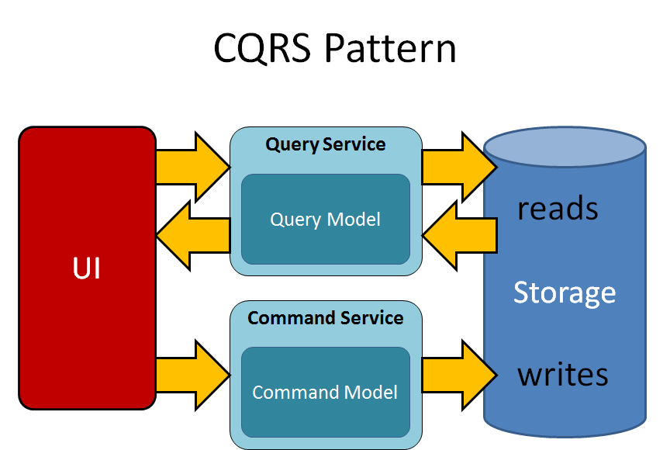
Notes:
http://www.ouarzy.com/2016/10/02/a-few-myths-about-cqrs/

Slide 75
Work at the right layer of abstraction
Recognize when is the abstraction is wrong
Experiment with new abstractions
Notes:
Understand what rules you are following, recognize when you are following the wrong rules
And sometimes… make up new ones

Slide 76


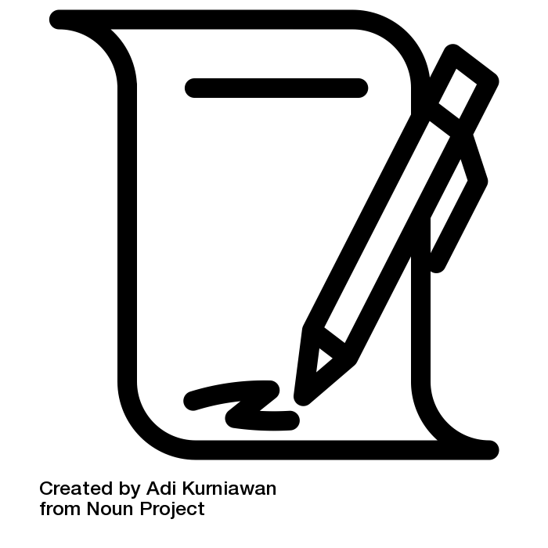
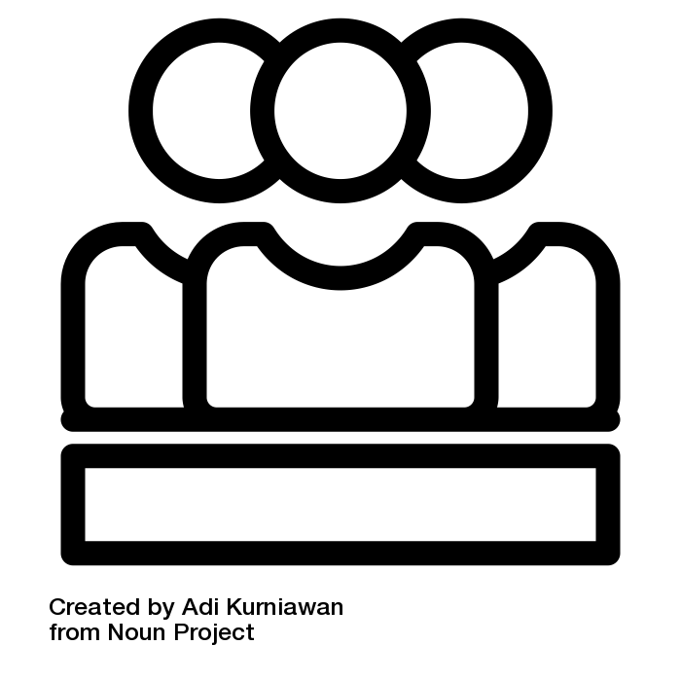
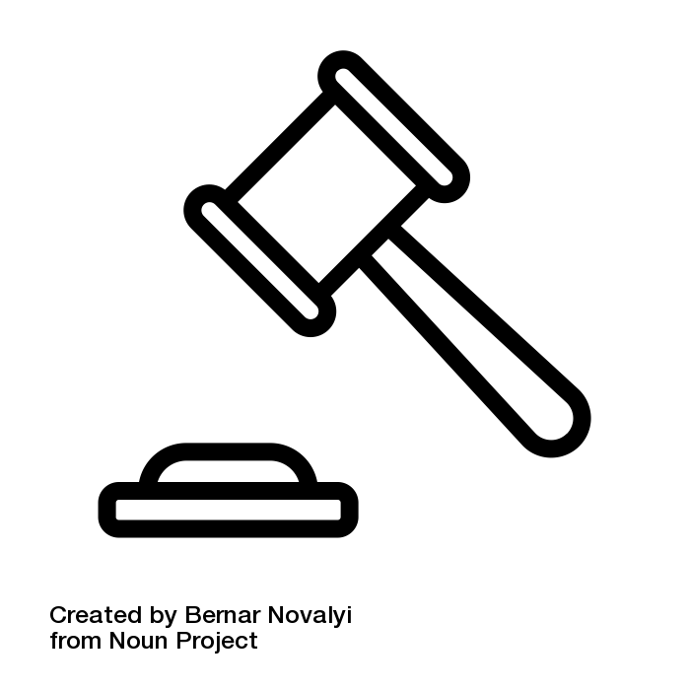




court by Adi Kurniawan from the Noun Project
Gavel by David from the Noun Project
Legal Document by Adi Kurniawan from the Noun Project
witness by Adi Kurniawan from the Noun Project
Gavel by Bernar Novalyi
from the Noun Project
Scale by Adi Kurniawan from the Noun Project
Gavel by Royyan Razka from the Noun Project
consent by Wichai Wi from the Noun Project
Ultrasaurus by Dactrtr from the Noun Project

Slide 77
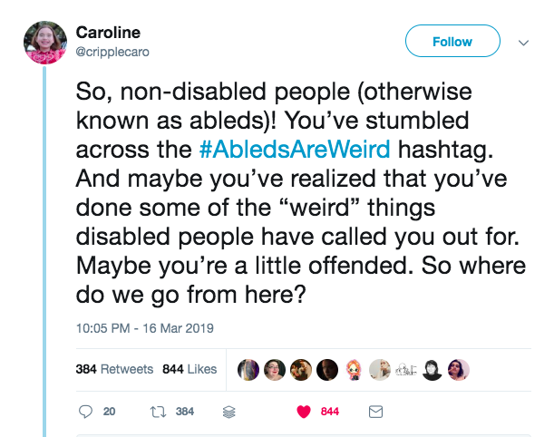

Slide 78
Work at the right layer of abstraction.
Recognize when the abstraction is incorrect.
The only constant is change.

Slide 79



Bridge Foundry

Slide 80

Practice
Guidance
Policy
Regulation
Law
The Constitution

Slide 81

Patternicity
Michael Shermer
Apophenia
Klaus Conrad
Notes:
https://michaelshermer.com/the-believing-brain/
https://www.psychologytoday.com/us/blog/reality-play/201207/being-amused-apophenia

Slide 82
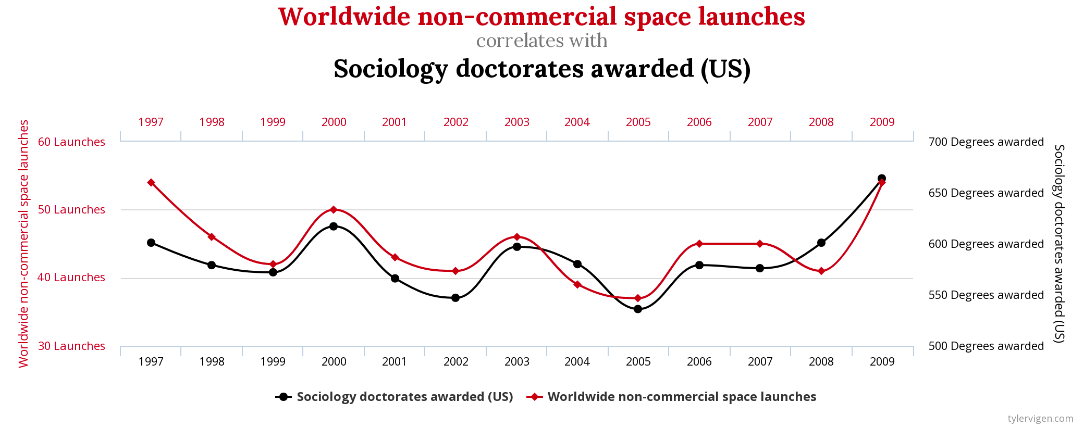
http://www.tylervigen.com/spurious-correlations
Notes:
Humans see patterns.

Slide 83
Type I error: false positive.
Notes:
Humans are very good at detecting patterns. It let’s us discover meaning when faced with a potentially overwheming amount of data. “Without such meaning-making, we would be unable to make predictions about survival and reproduction. The natural and interpersonal world around us would be too chaotic.”
https://www.psychologytoday.com/us/blog/reality-play/201207/being-amused-apophenia

Slide 84
Type I error: false positive.
Type II error: false negative.
Notes:
The Type II error, seeing no pattern where a pattern exists, turns out to be more dangerous.
https://www.psychologytoday.com/us/blog/reality-play/201207/being-amused-apophenia

Slide 85
“first you learn the value of abstraction, then you learn the cost of abstraction, then you're ready to engineer”
— Beck
Notes:
https://twitter.com/kentbeck/status/258316233068396544?lang=en

